Slide 1
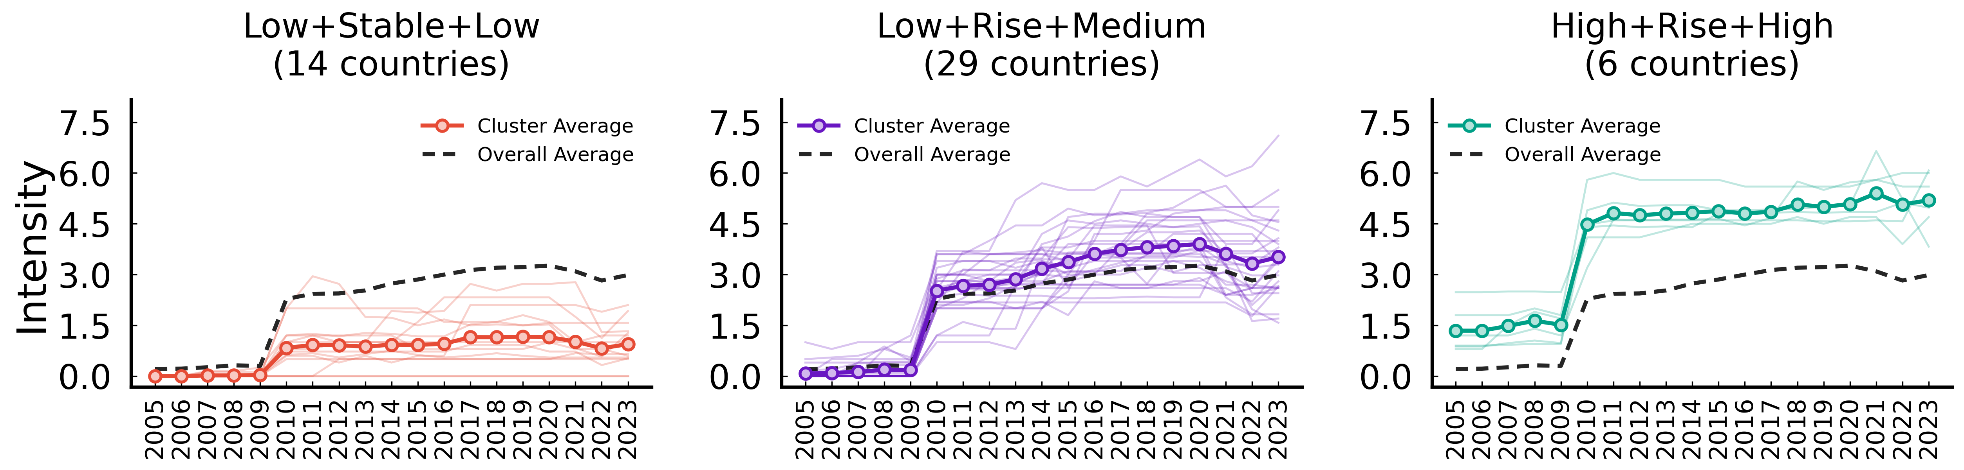
Buildings – market-based instruments (Intensity)
ID | Trajectory Features | Mean Start | Countries
Cluster 0 | Low -> Rise -> Low | 0.007 | 14 (ARG, BGR, CRI, EST, GRC, HRV, IDN, LTU, LVA, ML...)
Cluster 2 | Low -> Rise -> Medium | 0.100 | 29 (AUS, BEL, CAN, CHE, CHL, CHN, COL, CZE, ESP, FR...)
Cluster 1 | High -> Rise -> High | 1.389 | 6 (AUT, DEU, DNK, FIN, NOR, SWE)

Slide 2
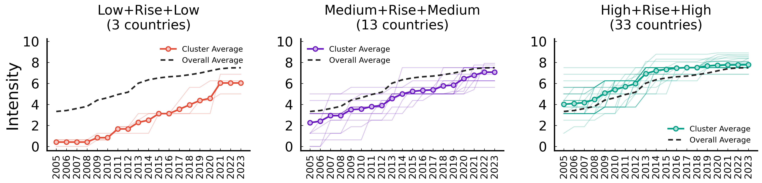
Buildings – non market-based instruments (Intensity)
ID | Trajectory Features | Mean Start | Countries
Cluster 1 | Low -> Rise -> Low | 0.417 | 3 (COL, ISL, PER)
Cluster 2 | Low -> Rise -> Medium | 2.532 | 13 (ARG, CHL, CRI, HRV, IDN, IND, ISR, LTU, ROU, SA...)
Cluster 0 | High -> Rise -> Medium | 4.091 | 33 (AUS, AUT, BEL, BGR, CAN, CHE, CHN, CZE, DEU, DN...)

Slide 3
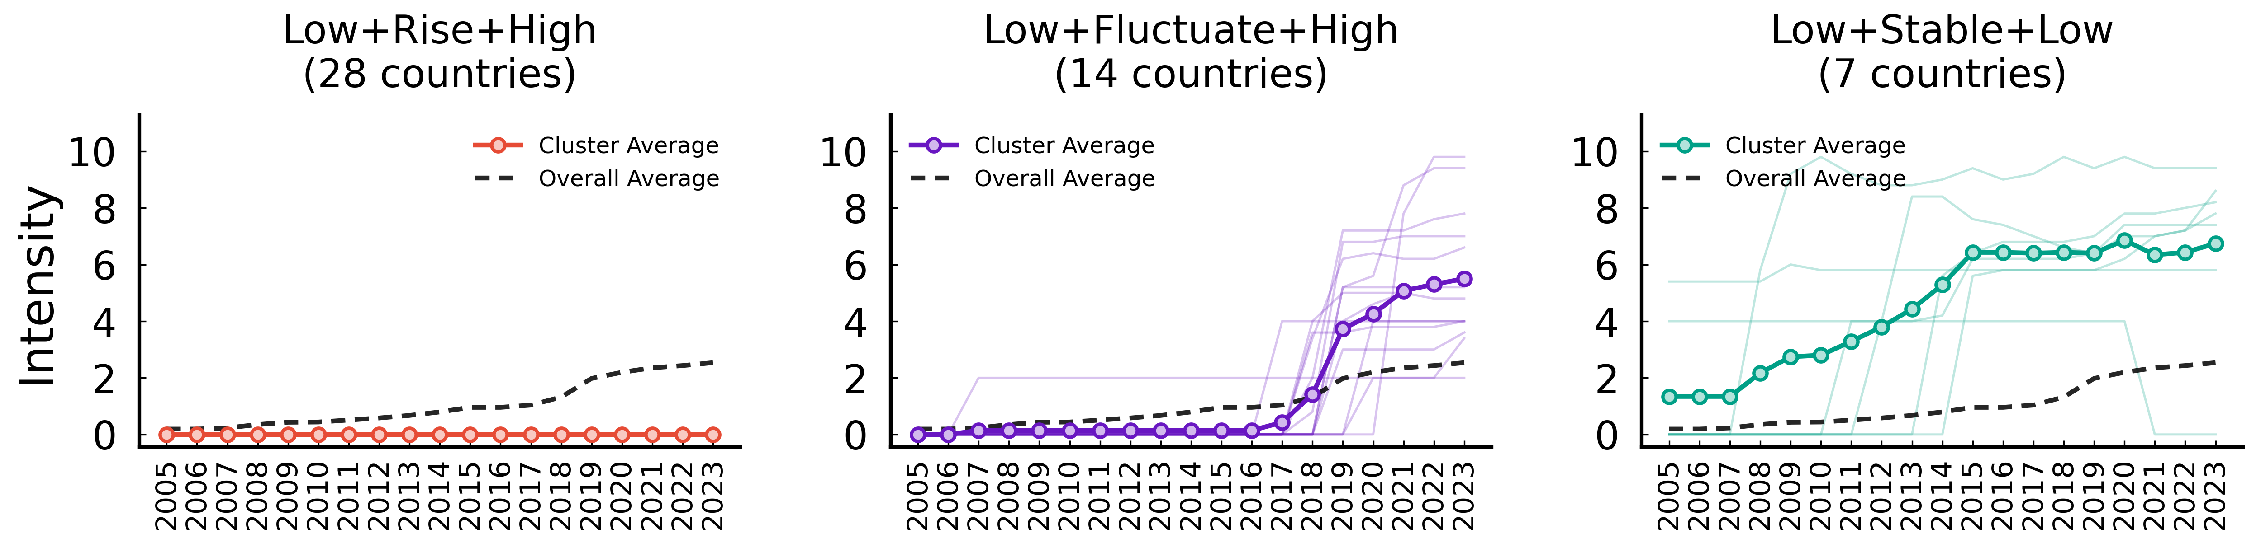
Climate governance (Intensity)
ID | Trajectory Features | Mean Start | Countries
Cluster 1 | Low -> Stable -> Low | 0.000 | 28 (ARG, AUT, BEL, BGR, CZE, ESP, EST, HRV, HUN, ID...)
Cluster 2 | Low -> Rise -> High | 0.048 | 14 (CAN, CHL, CHN, COL, CRI, DEU, FRA, GRC, ISL, KO...)
Cluster 0 | High -> Rise -> High | 1.343 | 7 (AUS, CHE, DNK, FIN, GBR, IRL, LTU)

Slide 4
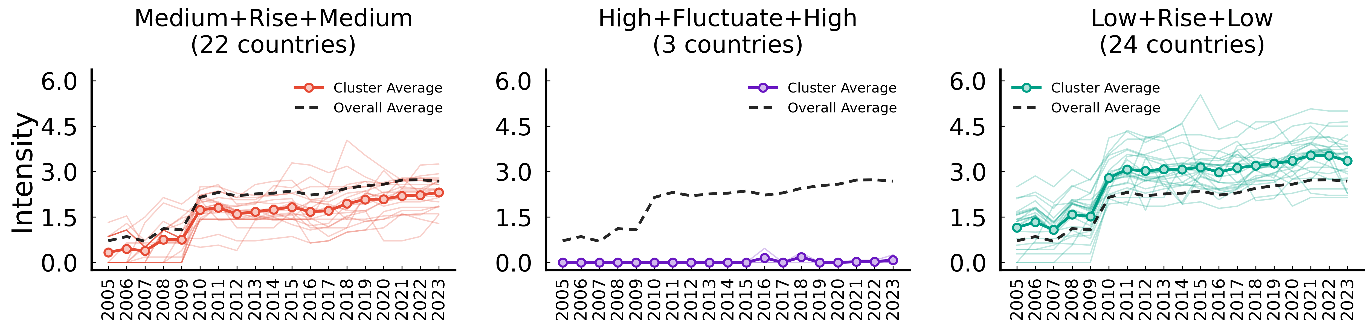
Electricity – market-based instruments (Intensity)
ID | Trajectory Features | Mean Start | Countries
Cluster 2 | Low -> Rise -> Low | 0.389 | 22 (ARG, BGR, CHN, COL, CRI, DNK, FIN, GRC, HRV, HU...)
Cluster 1 | Low -> Stable -> Low | 0.000 | 3 (PER, RUS, SAU)
Cluster 0 | High -> Rise -> High | 1.188 | 24 (AUS, AUT, BEL, CAN, CHE, CHL, CZE, DEU, ESP, ES...)

Slide 5
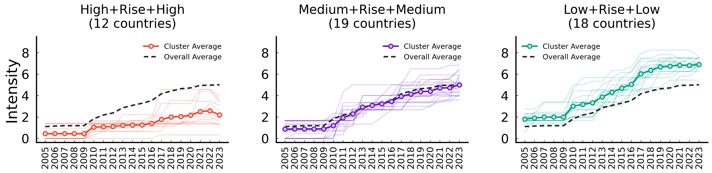
Electricity – non market-based instruments (Intensity)
ID | Trajectory Features | Mean Start | Countries
Cluster 1 | Low -> Rise -> Low | 0.449 | 12 (ARG, COL, CRI, IDN, ISL, ISR, MLT, NZL, PER, RU...)
Cluster 2 | Medium -> Rise -> Medium | 0.881 | 19 (BGR, CHL, CHN, CZE, EST, HRV, HUN, IND, JPN, LT...)
Cluster 0 | High -> Rise -> High | 1.896 | 18 (AUS, AUT, BEL, CAN, CHE, DEU, DNK, ESP, FIN, FR...)

Slide 6
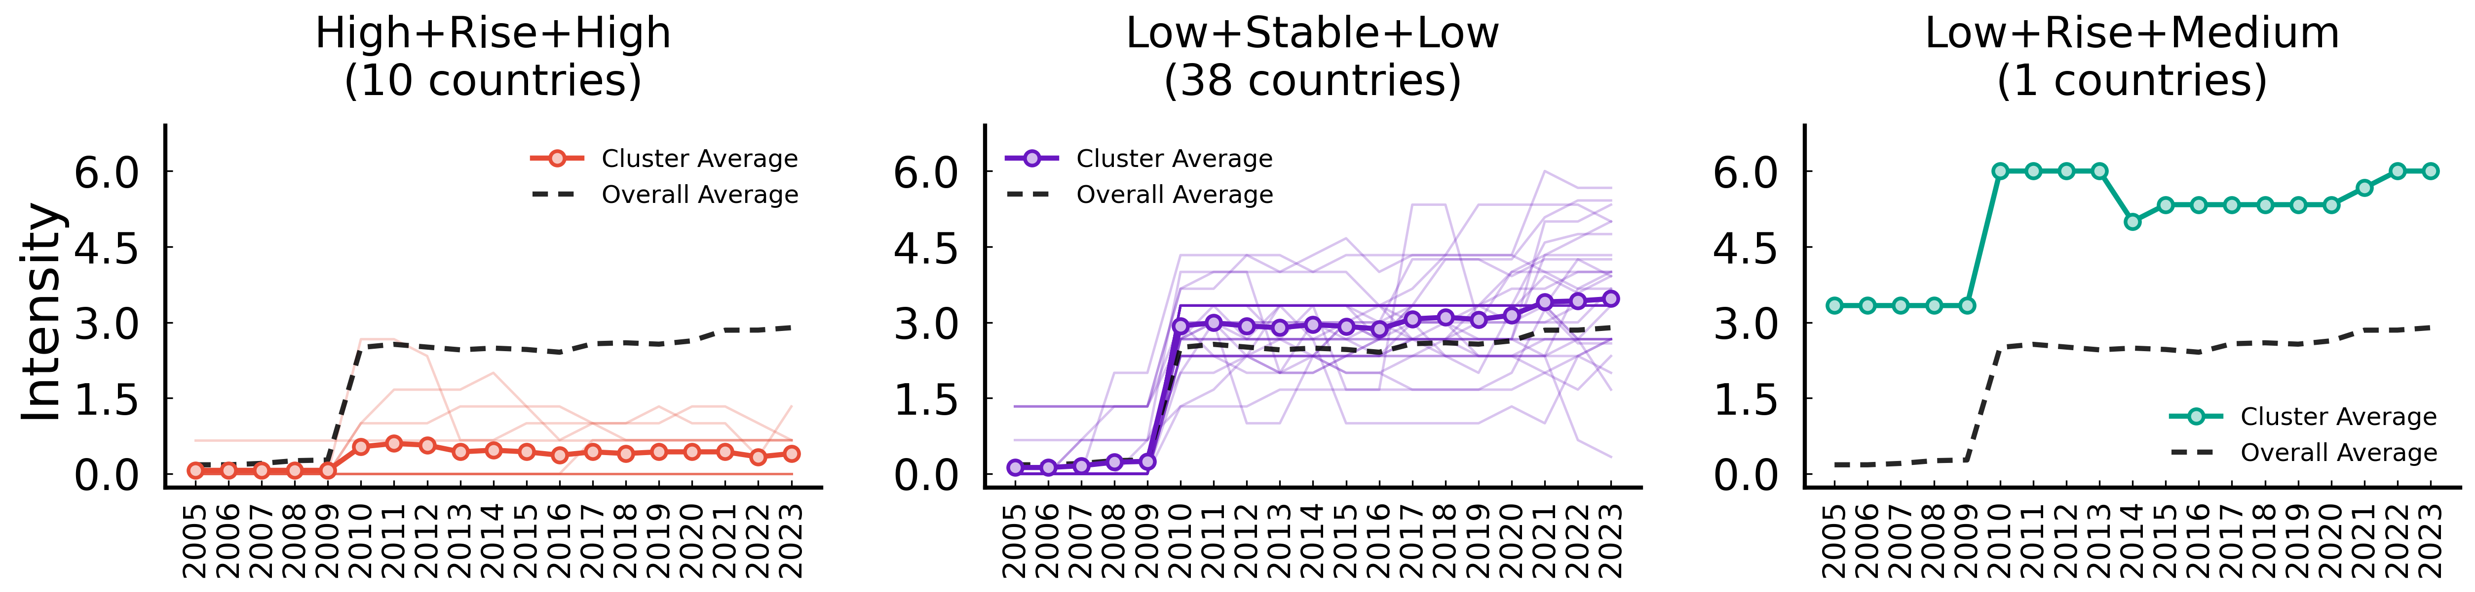
Fossil fuel production policies (Intensity)
ID | Trajectory Features | Mean Start | Countries
Cluster 0 | Low -> Stable -> Low | 0.067 | 10 (BGR, HRV, IDN, IND, MLT, PER, POL, ROU, RUS, SAU)
Cluster 1 | Low -> Rise -> Medium | 0.135 | 38 (ARG, AUS, AUT, BEL, CAN, CHE, CHL, CHN, COL, CR...)
Cluster 2 | High -> Fluctuate -> High | 3.333 | 1 (NOR)

Slide 7
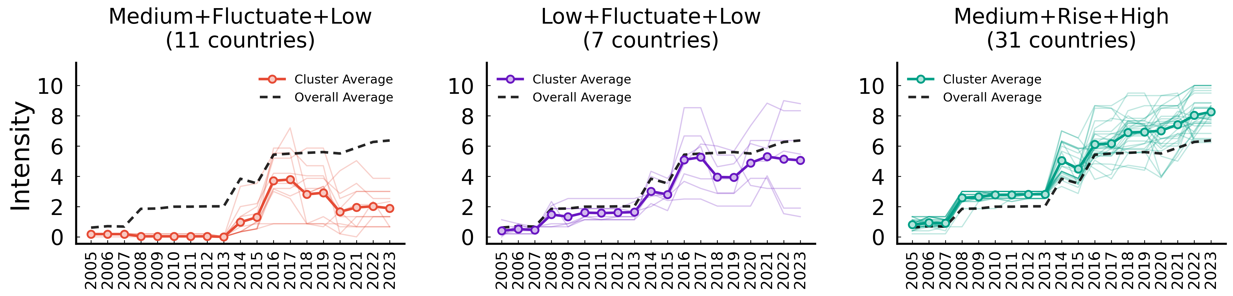
GHG emissions data and reporting (Intensity)
ID | Trajectory Features | Mean Start | Countries
Cluster 1 | Low -> Fluctuate -> Low | 0.182 | 11 (ARG, CHL, CHN, COL, CRI, IDN, IND, ISR, PER, SA...)
Cluster 2 | Low -> Fluctuate -> Medium | 0.457 | 7 (HRV, JPN, KOR, MEX, NZL, RUS, TUR)
Cluster 0 | Medium -> Rise -> High | 0.884 | 31 (AUS, AUT, BEL, BGR, CAN, CHE, CZE, DEU, DNK, ES...)

Slide 8
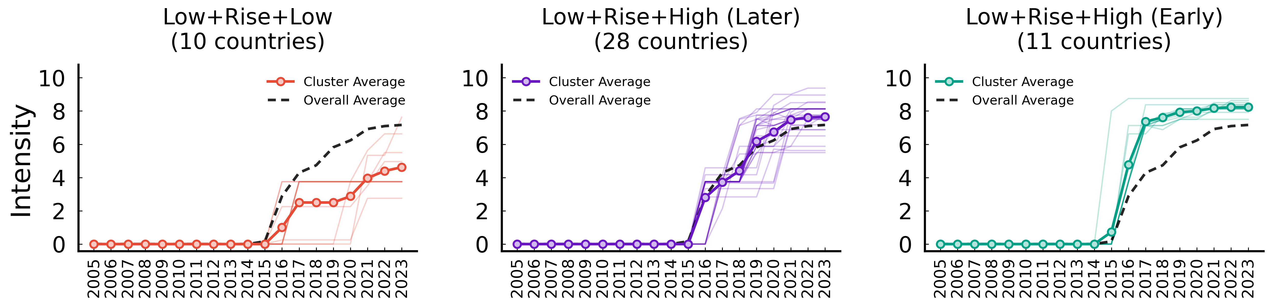
GHG emissions targets (Intensity)
ID | Trajectory Features | Mean Start | Countries
Cluster 0 | Low -> Rise -> Low | 0.000 | 10 (BEL, CZE, IND, MEX, NLD, POL, ROU, RUS, SAU, TUR)
Cluster 2 | Low -> Rise -> Medium | 0.000 | 28 (ARG, AUS, AUT, BGR, CAN, CHE, CHL, CHN, COL, DN...)
Cluster 1 | Low -> Rise -> High | 0.000 | 11 (CRI, DEU, FIN, FRA, GBR, ISL, LUX, NOR, NZL, PR...)

Slide 9
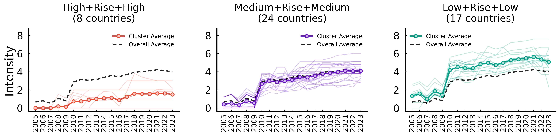
Industry – market-based instruments (Intensity)
ID | Trajectory Features | Mean Start | Countries
Cluster 1 | Low -> Rise -> Low | 0.000 | 8 (ARG, CRI, HRV, IDN, MLT, PER, RUS, SAU)
Cluster 2 | Low -> Rise -> Medium | 0.416 | 24 (AUS, BEL, BGR, CHE, CHL, CHN, COL, EST, FIN, GR...)
Cluster 0 | High -> Rise -> High | 1.316 | 17 (AUT, CAN, CZE, DEU, DNK, ESP, FRA, GBR, HUN, IR...)

Slide 10
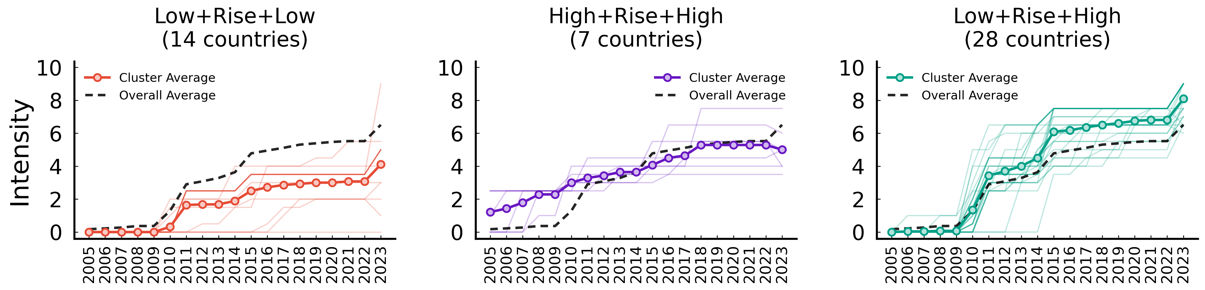
Industry – non market-based instruments (Intensity)
ID | Trajectory Features | Mean Start | Countries
Cluster 0 | Low -> Rise -> Medium | 0.000 | 14 (ARG, COL, EST, IDN, ISL, LTU, LUX, LVA, MLT, PE...)
Cluster 1 | High -> Rise -> Medium | 1.476 | 7 (AUS, CAN, CHL, CRI, KOR, MEX, NZL)
Cluster 2 | Low -> Rise -> High | 0.024 | 28 (AUT, BEL, BGR, CHE, CHN, CZE, DEU, DNK, ESP, FI...)

Slide 11
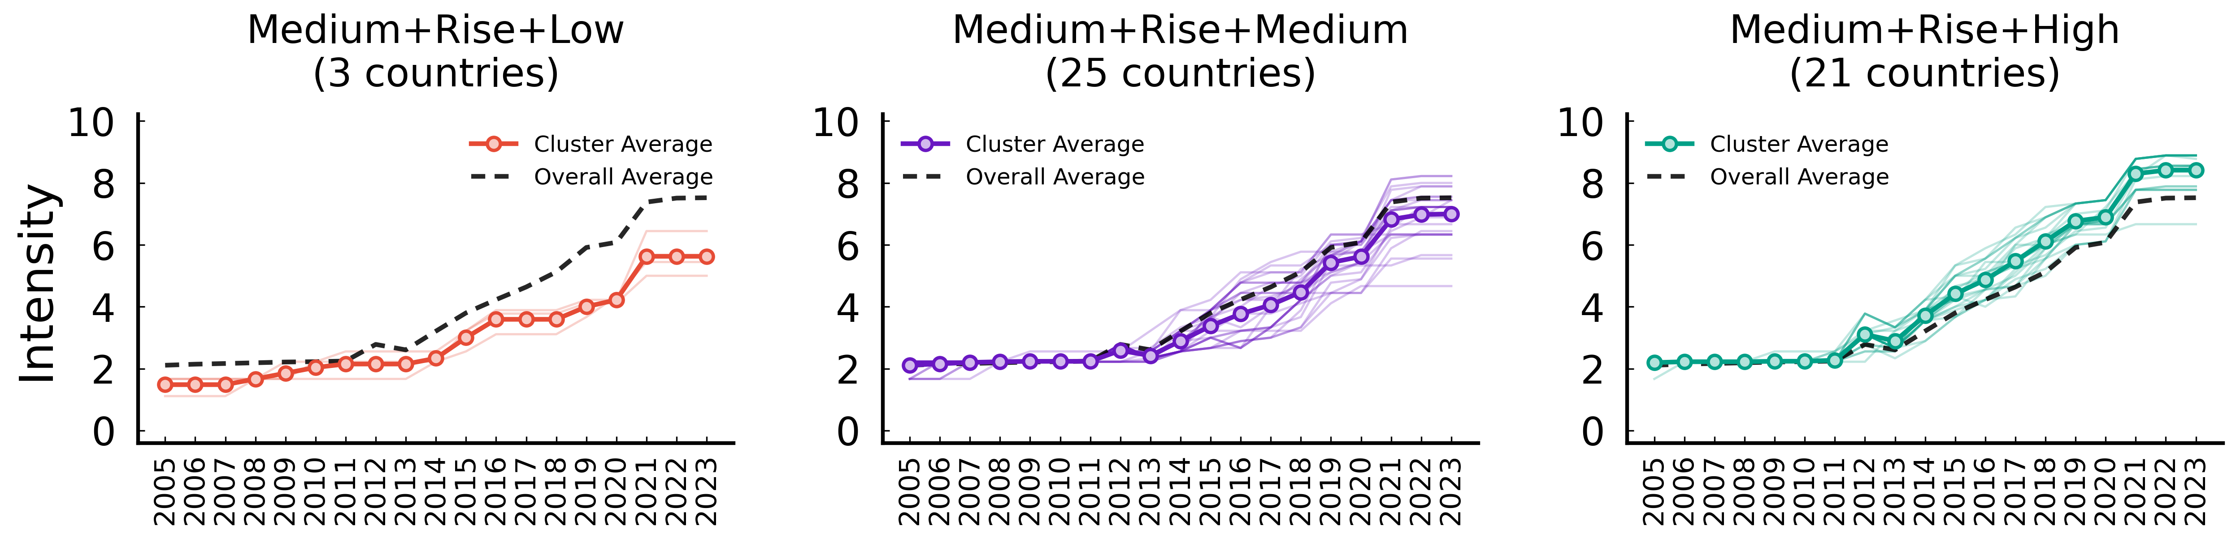
International climate co-operation (Intensity)
ID | Trajectory Features | Mean Start | Countries
Cluster 1 | Low -> Rise -> Low | 1.481 | 3 (CHN, SAU, TUR)
Cluster 2 | Medium -> Rise -> Medium | 2.156 | 25 (ARG, AUS, BGR, CAN, COL, CZE, ESP, EST, GRC, HR...)
Cluster 0 | Medium -> Rise -> High | 2.213 | 21 (AUT, BEL, CHE, CHL, CRI, DEU, DNK, FIN, FRA, GB...)

Slide 12
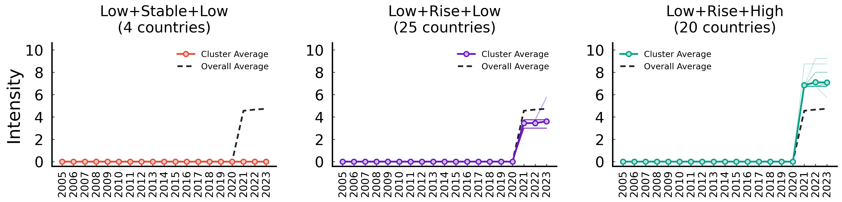
International public finance (Intensity)
ID | Trajectory Features | Mean Start | Countries
Cluster 1 | Low -> Stable -> Low | 0.000 | 4 (CHL, COL, ISR, PER)
Cluster 2 | Low -> Rise -> Low | 0.000 | 25 (ARG, AUT, BGR, CHN, CRI, CZE, EST, GRC, HRV, HU...)
Cluster 0 | Low -> Rise -> High | 0.000 | 20 (AUS, BEL, CAN, CHE, DEU, DNK, ESP, FIN, FRA, GB...)

Slide 13
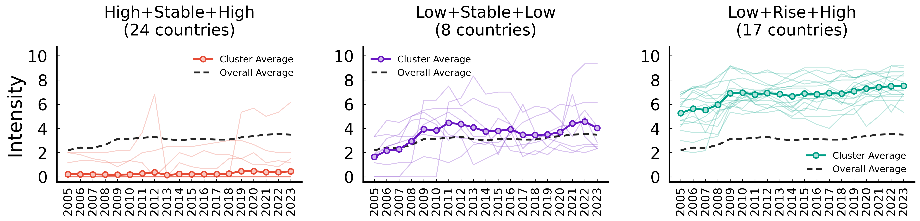
Public Research, Development and Demonstration (Intensity)
ID | Trajectory Features | Mean Start | Countries
Cluster 0 | Low -> Stable -> Low | 0.211 | 24 (ARG, BGR, CHL, CHN, COL, CRI, GRC, HRV, IDN, IN...)
Cluster 1 | Medium -> Fluctuate -> Medium | 2.028 | 8 (ESP, EST, HUN, IRL, NZL, POL, PRT, SVK)
Cluster 2 | High -> Rise -> High | 5.477 | 17 (AUS, AUT, BEL, CAN, CHE, CZE, DEU, DNK, FIN, FR...)

Slide 14
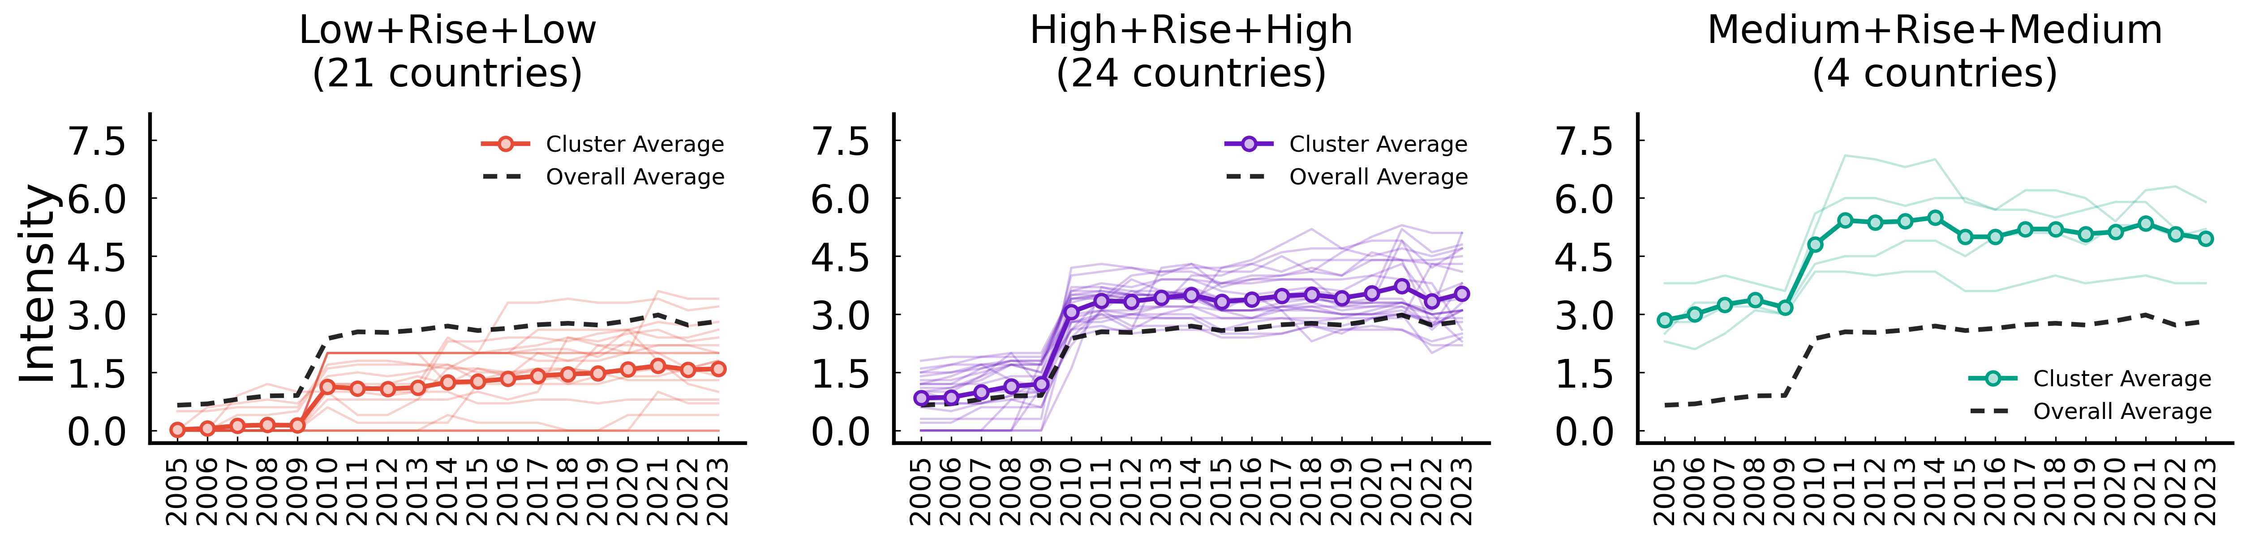
Transport – market-based instruments (Intensity)
ID | Trajectory Features | Mean Start | Countries
Cluster 0 | Low -> Rise -> Low | 0.067 | 21 (ARG, AUS, BGR, CHL, CHN, COL, CRI, EST, HRV, ID...)
Cluster 2 | Medium -> Rise -> High | 0.897 | 24 (AUT, BEL, CAN, CHE, CZE, DEU, ESP, FIN, FRA, GR...)
Cluster 1 | High -> Rise -> High | 3.033 | 4 (DNK, GBR, NOR, SWE)

Slide 15
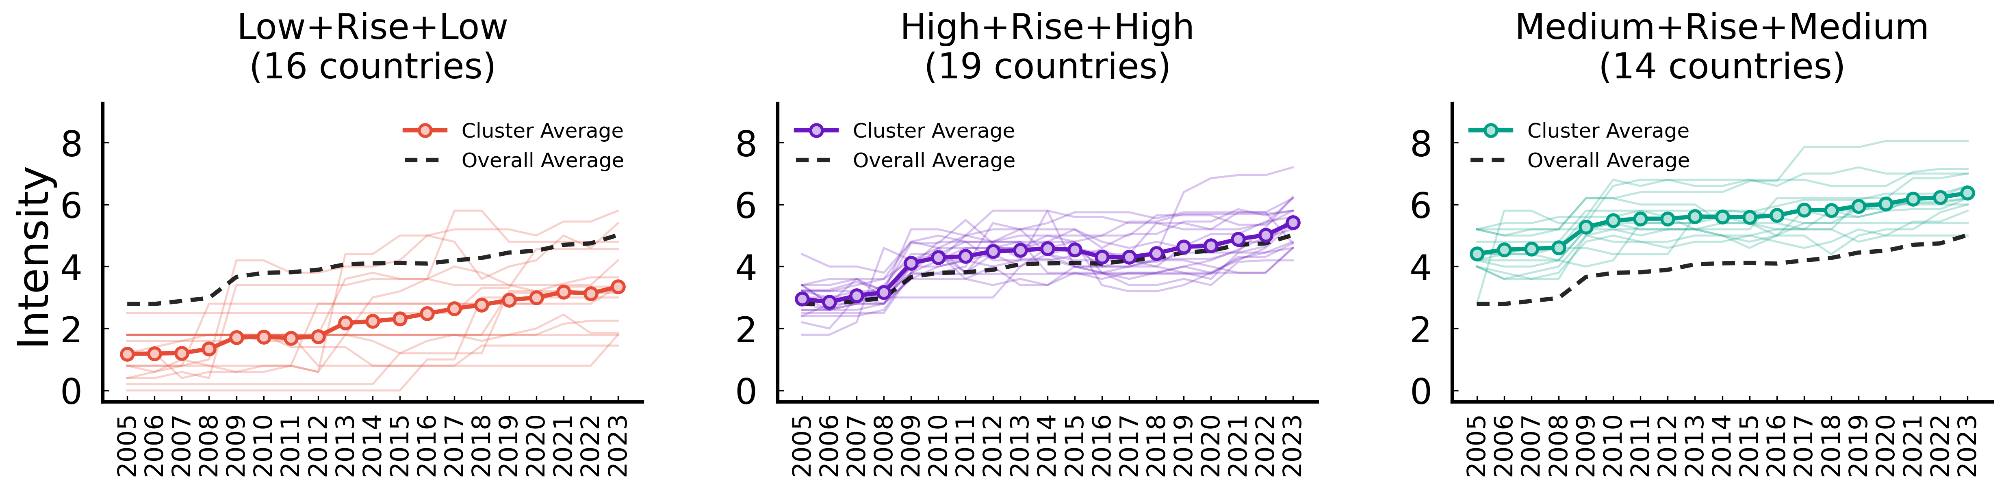
Transport – non market-based instruments (Intensity)
ID | Trajectory Features | Mean Start | Countries
Cluster 0 | Low -> Rise -> Low | 1.194 | 16 (ARG, BGR, CHL, COL, CRI, HRV, IDN, IND, ISL, IS...)
Cluster 1 | Medium -> Rise -> Medium | 2.956 | 19 (CAN, CHN, CZE, DEU, DNK, EST, FRA, GRC, HUN, IR...)
Cluster 2 | High -> Rise -> High | 4.510 | 14 (AUS, AUT, BEL, CHE, ESP, FIN, GBR, ITA, JPN, KO...)

